Slide 1
Catching Fire
Reducing the Risk of Facility Fires
Kevin Roche
ecomaine

Slide 2
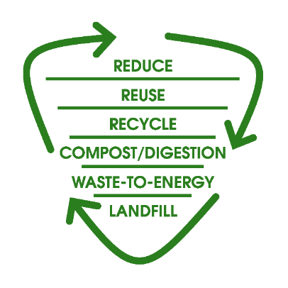
ecomaine
Our Mission
ecomaine provides comprehensive, long-term solid waste solutions in a safe, environmentally responsible, economically sound manner, and is a leader in raising public awareness of sustainable waste management strategies.
Notes:
Emphasis here on safety. Safety comes first in our mission statement.

Slide 3
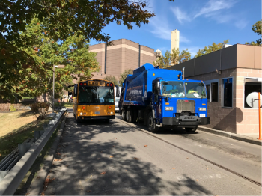
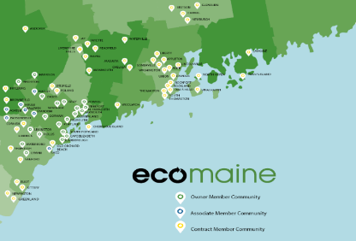
ecomaine’s Facilities & Programs
71 Communities
~400,000 people
Facilities:
Single-Sort Recycling
Food Waste Recovery
Waste-To-Energy Plant
Landfill/Ashfill
Programs:
Reaching 40,000 residents a year through Tours & School Presentations

Slide 4
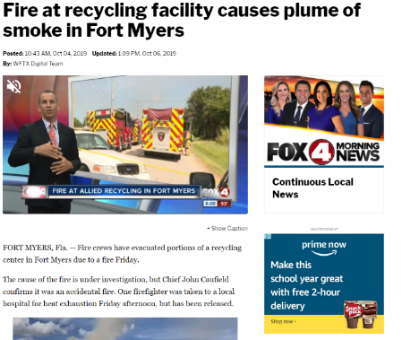
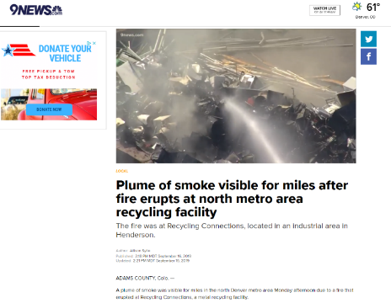
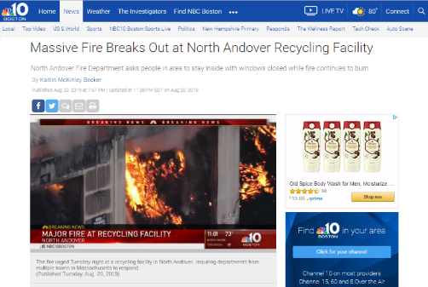
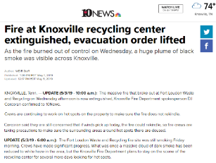
An Industry “Under Fire”

Slide 5
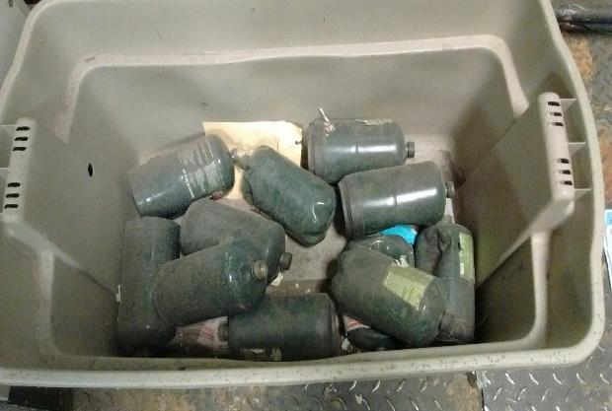
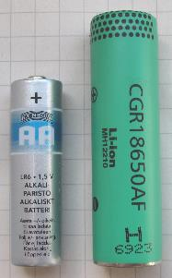
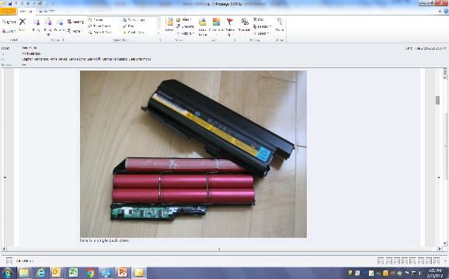
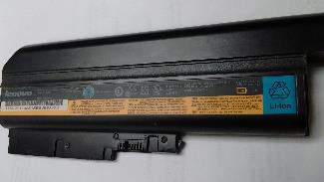
LI 18650 battery – 18 mm in diameter and 65 mm tall

Slide 6
ecomaine isn’t Immune…

Slide 7
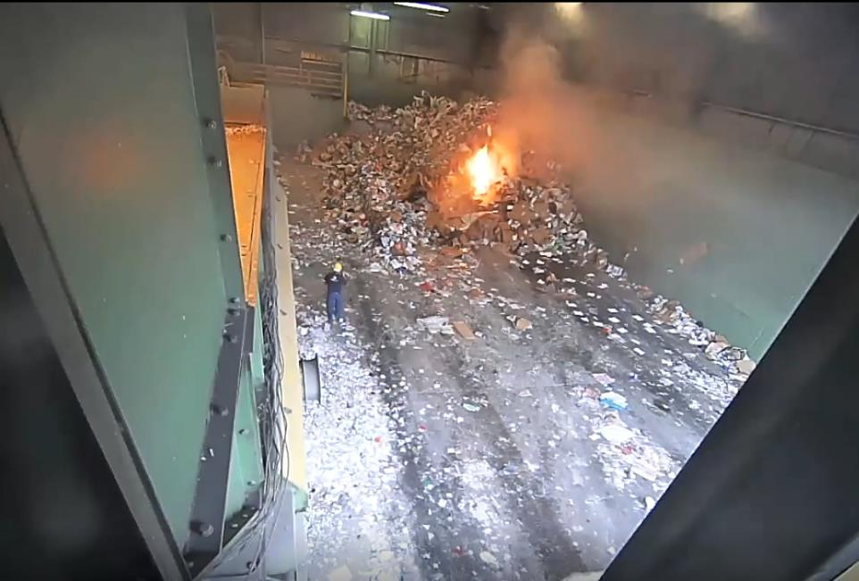
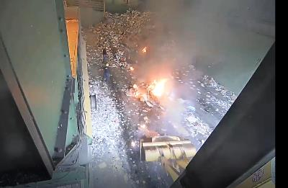

Slide 8
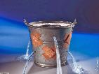
Change was Needed

Slide 9
Detect & Respond Early
Adding thermal camera technology in all high risk areas to improve coverage for early warning detection.
Notification – Set temperature thresholds that will alarm staff.
Staff can view and respond with inspections, water cannons, and/or trigger deluge systems.
Most importantly, staff can respond remotely (and safely).

Slide 10
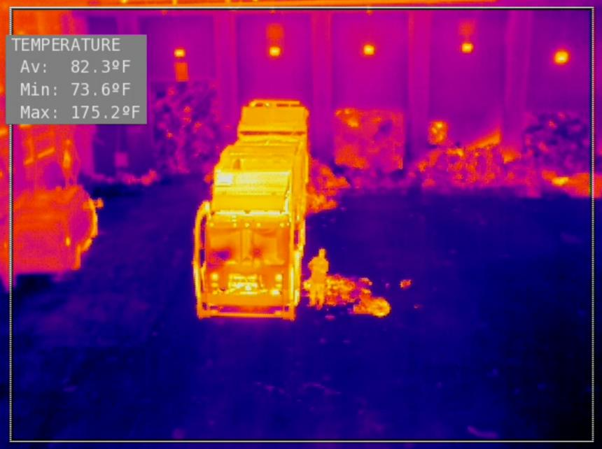
Thermal Cameras will monitor for “Hot Spots”

Slide 11
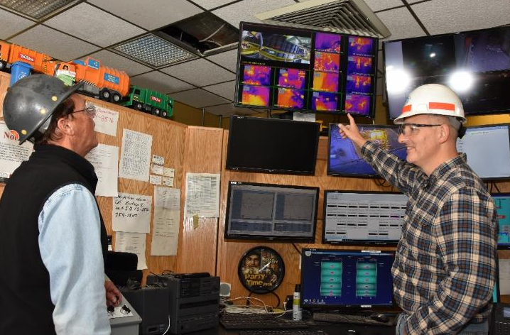

Slide 12
Fire Suppression Cannon in Action

Slide 13
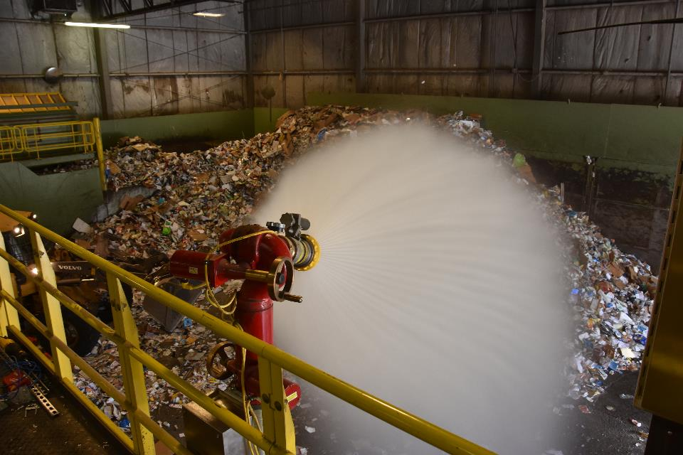
Water Cannon - Shower mode

Slide 14
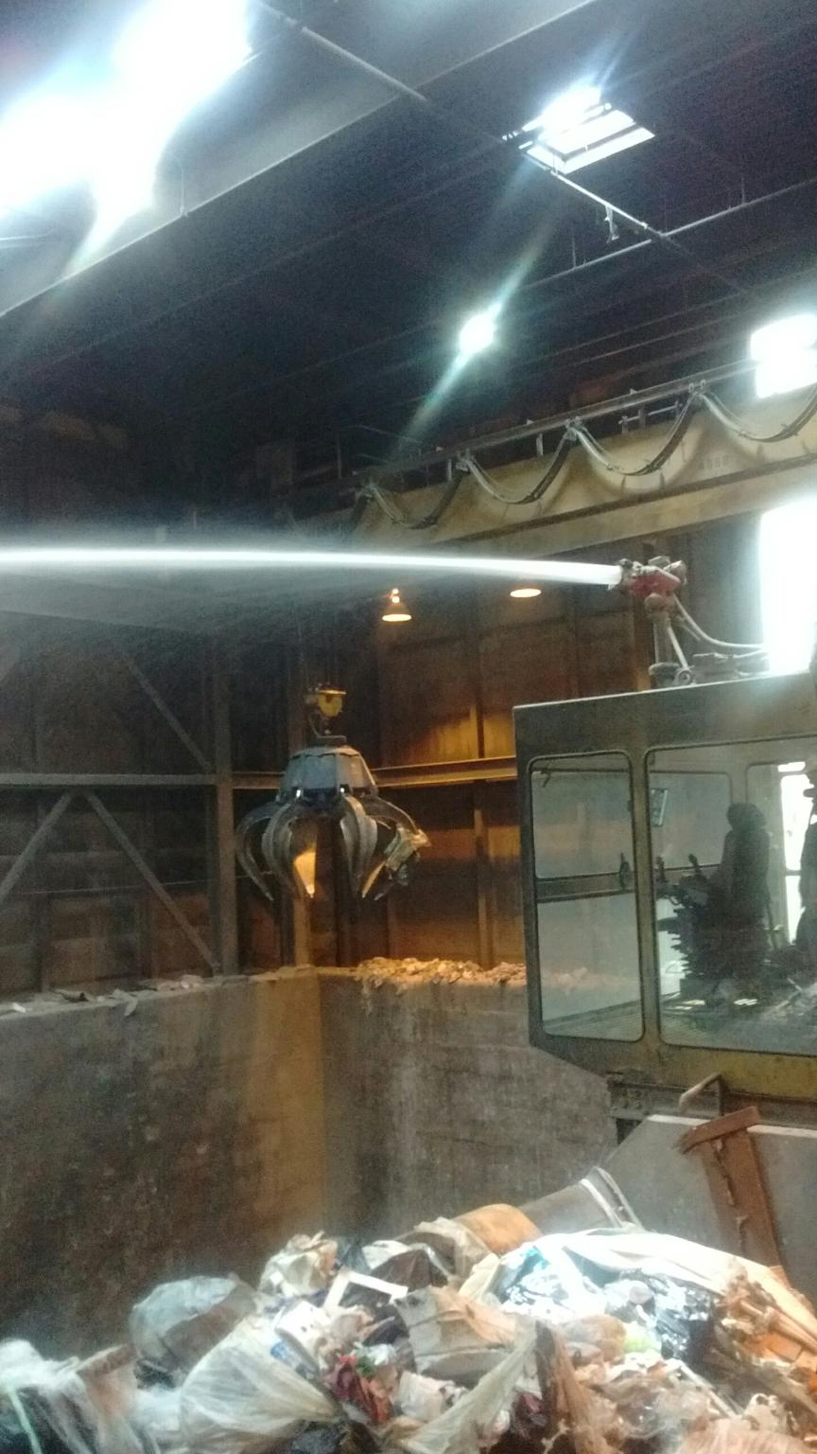

Slide 15
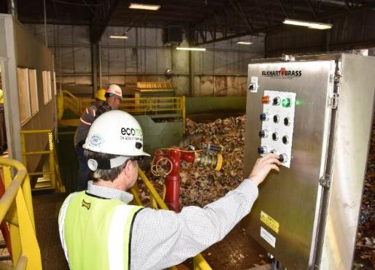
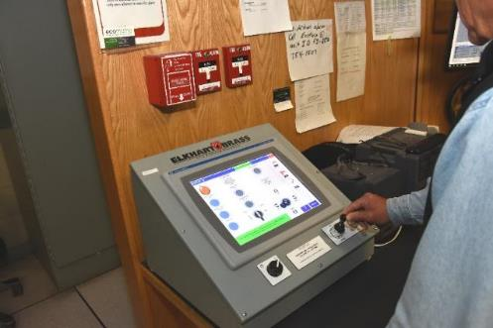
Controls Allows for Quicker & Safer Response
At the tipping floor…
Outside the facility…
At the water cannon…
… or remotely from our Waste-to-Energy Plant’s Control Room

Slide 16
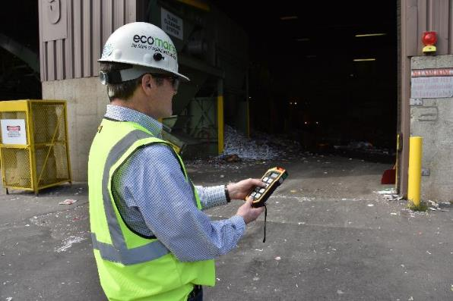
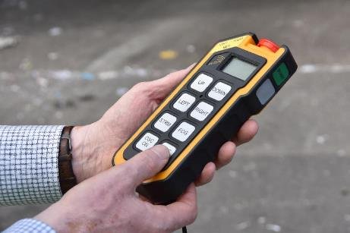
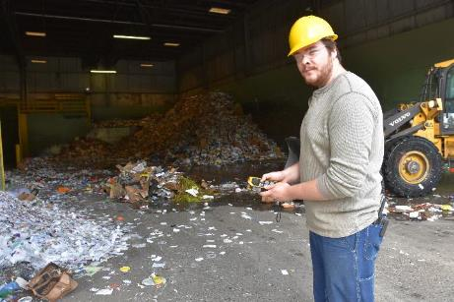
Responding by
Remote Control

Slide 17
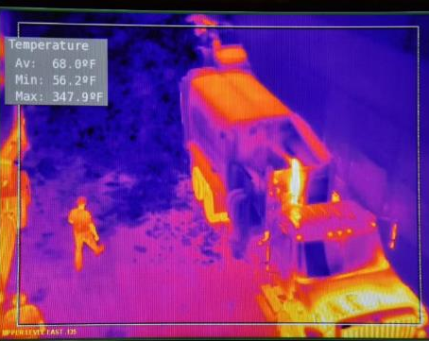
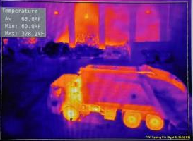
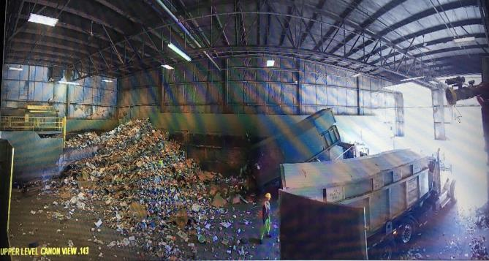
Growing Pains

Slide 18
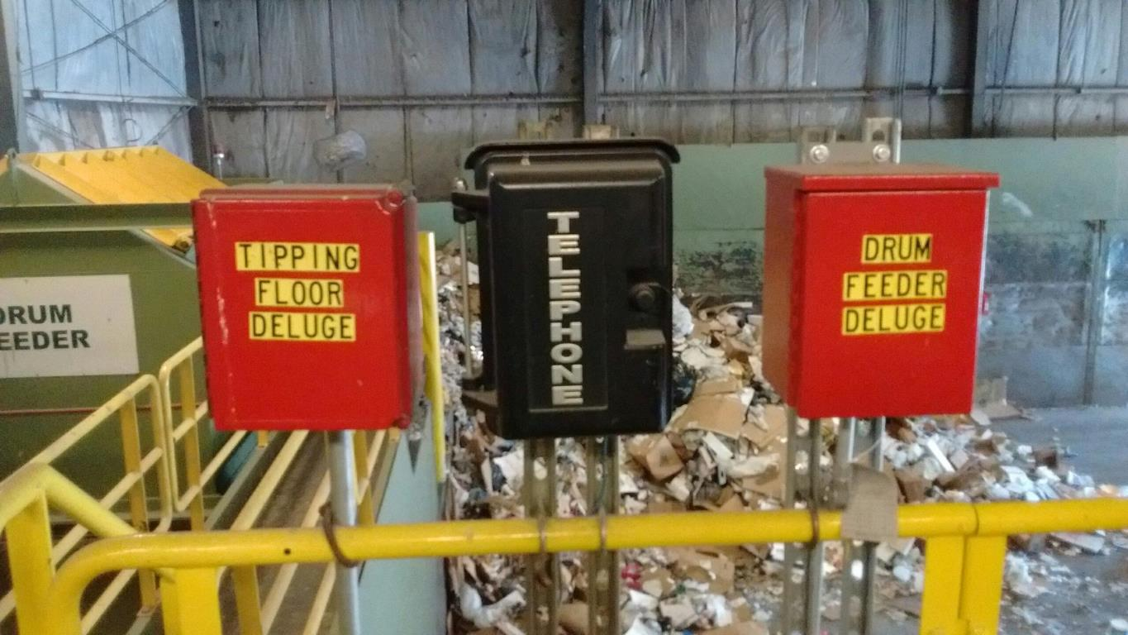

Slide 19
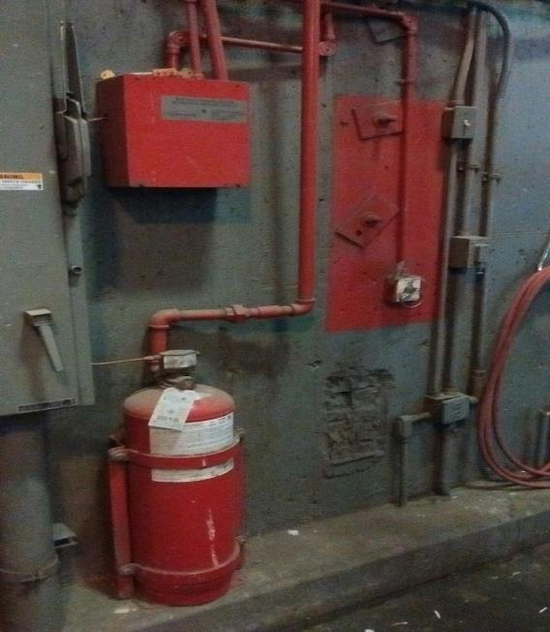
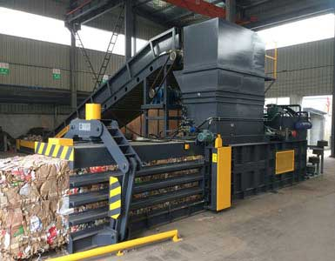
Protection for Balers - Manual Water Deluge and Automated Dry Chemical

Slide 20
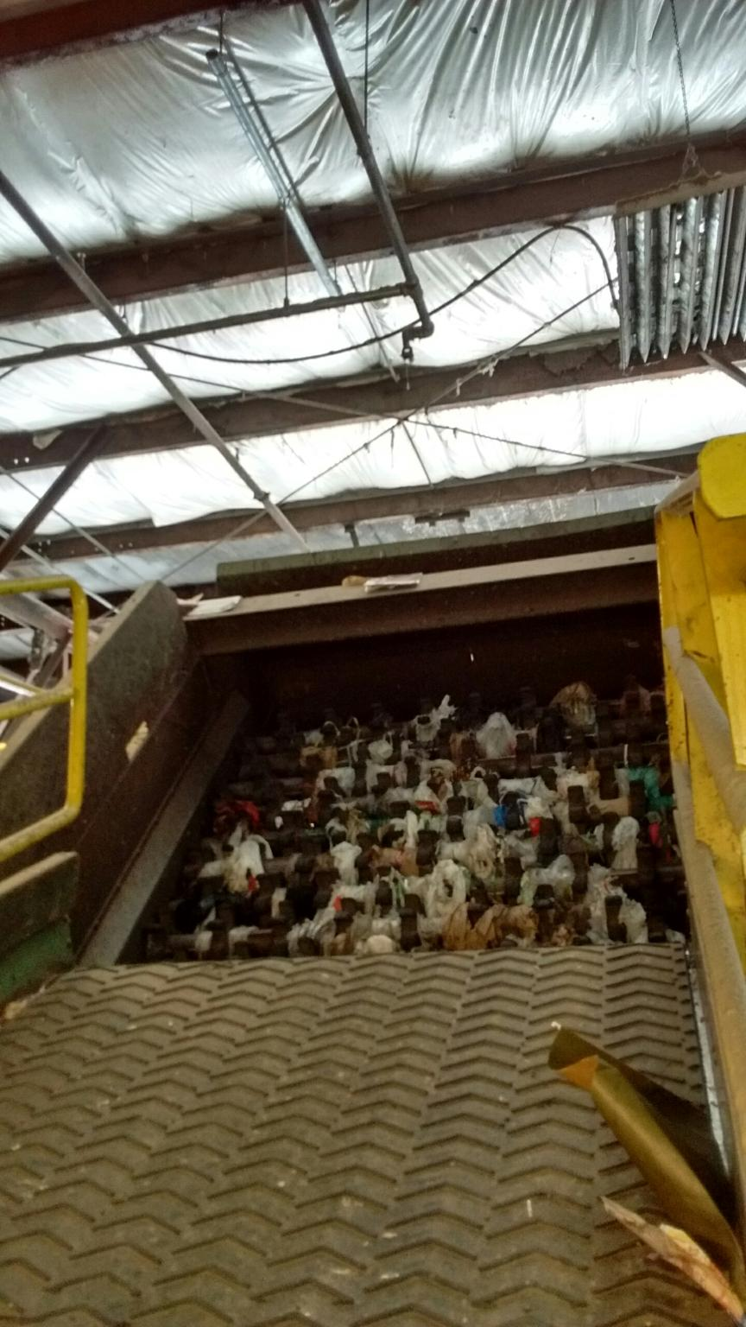
Water deluge over paper star screens

Slide 21
Keeping an Eye on our Safety and Resources

Slide 22
Cost
Thermal Cameras (8),
Alarm, Detection & Installation: $148k
Water Cannon & Installation: $96k
Total: $244k

Slide 23
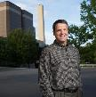
Catching Fire – Reduce the Risk
Thank you!
Kevin Roche
CEO
ecomaine

