Slide 1
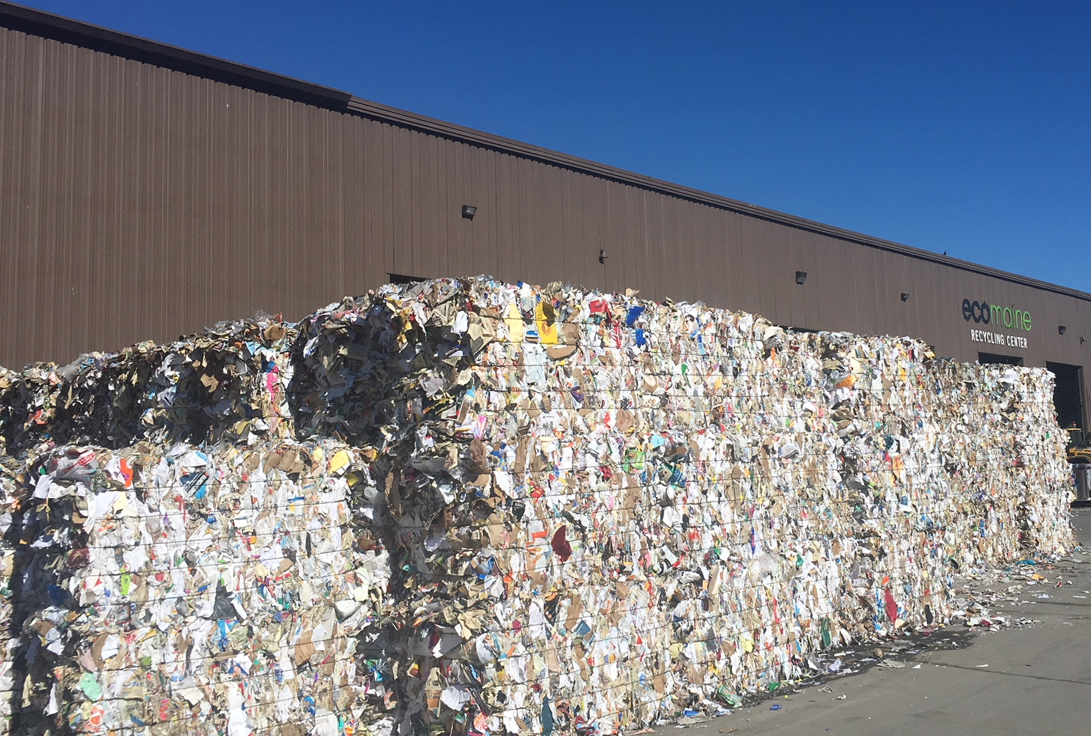
Recycled Paper Markets: From Boom to Bust
Kevin Roche
ecomaine

Slide 3
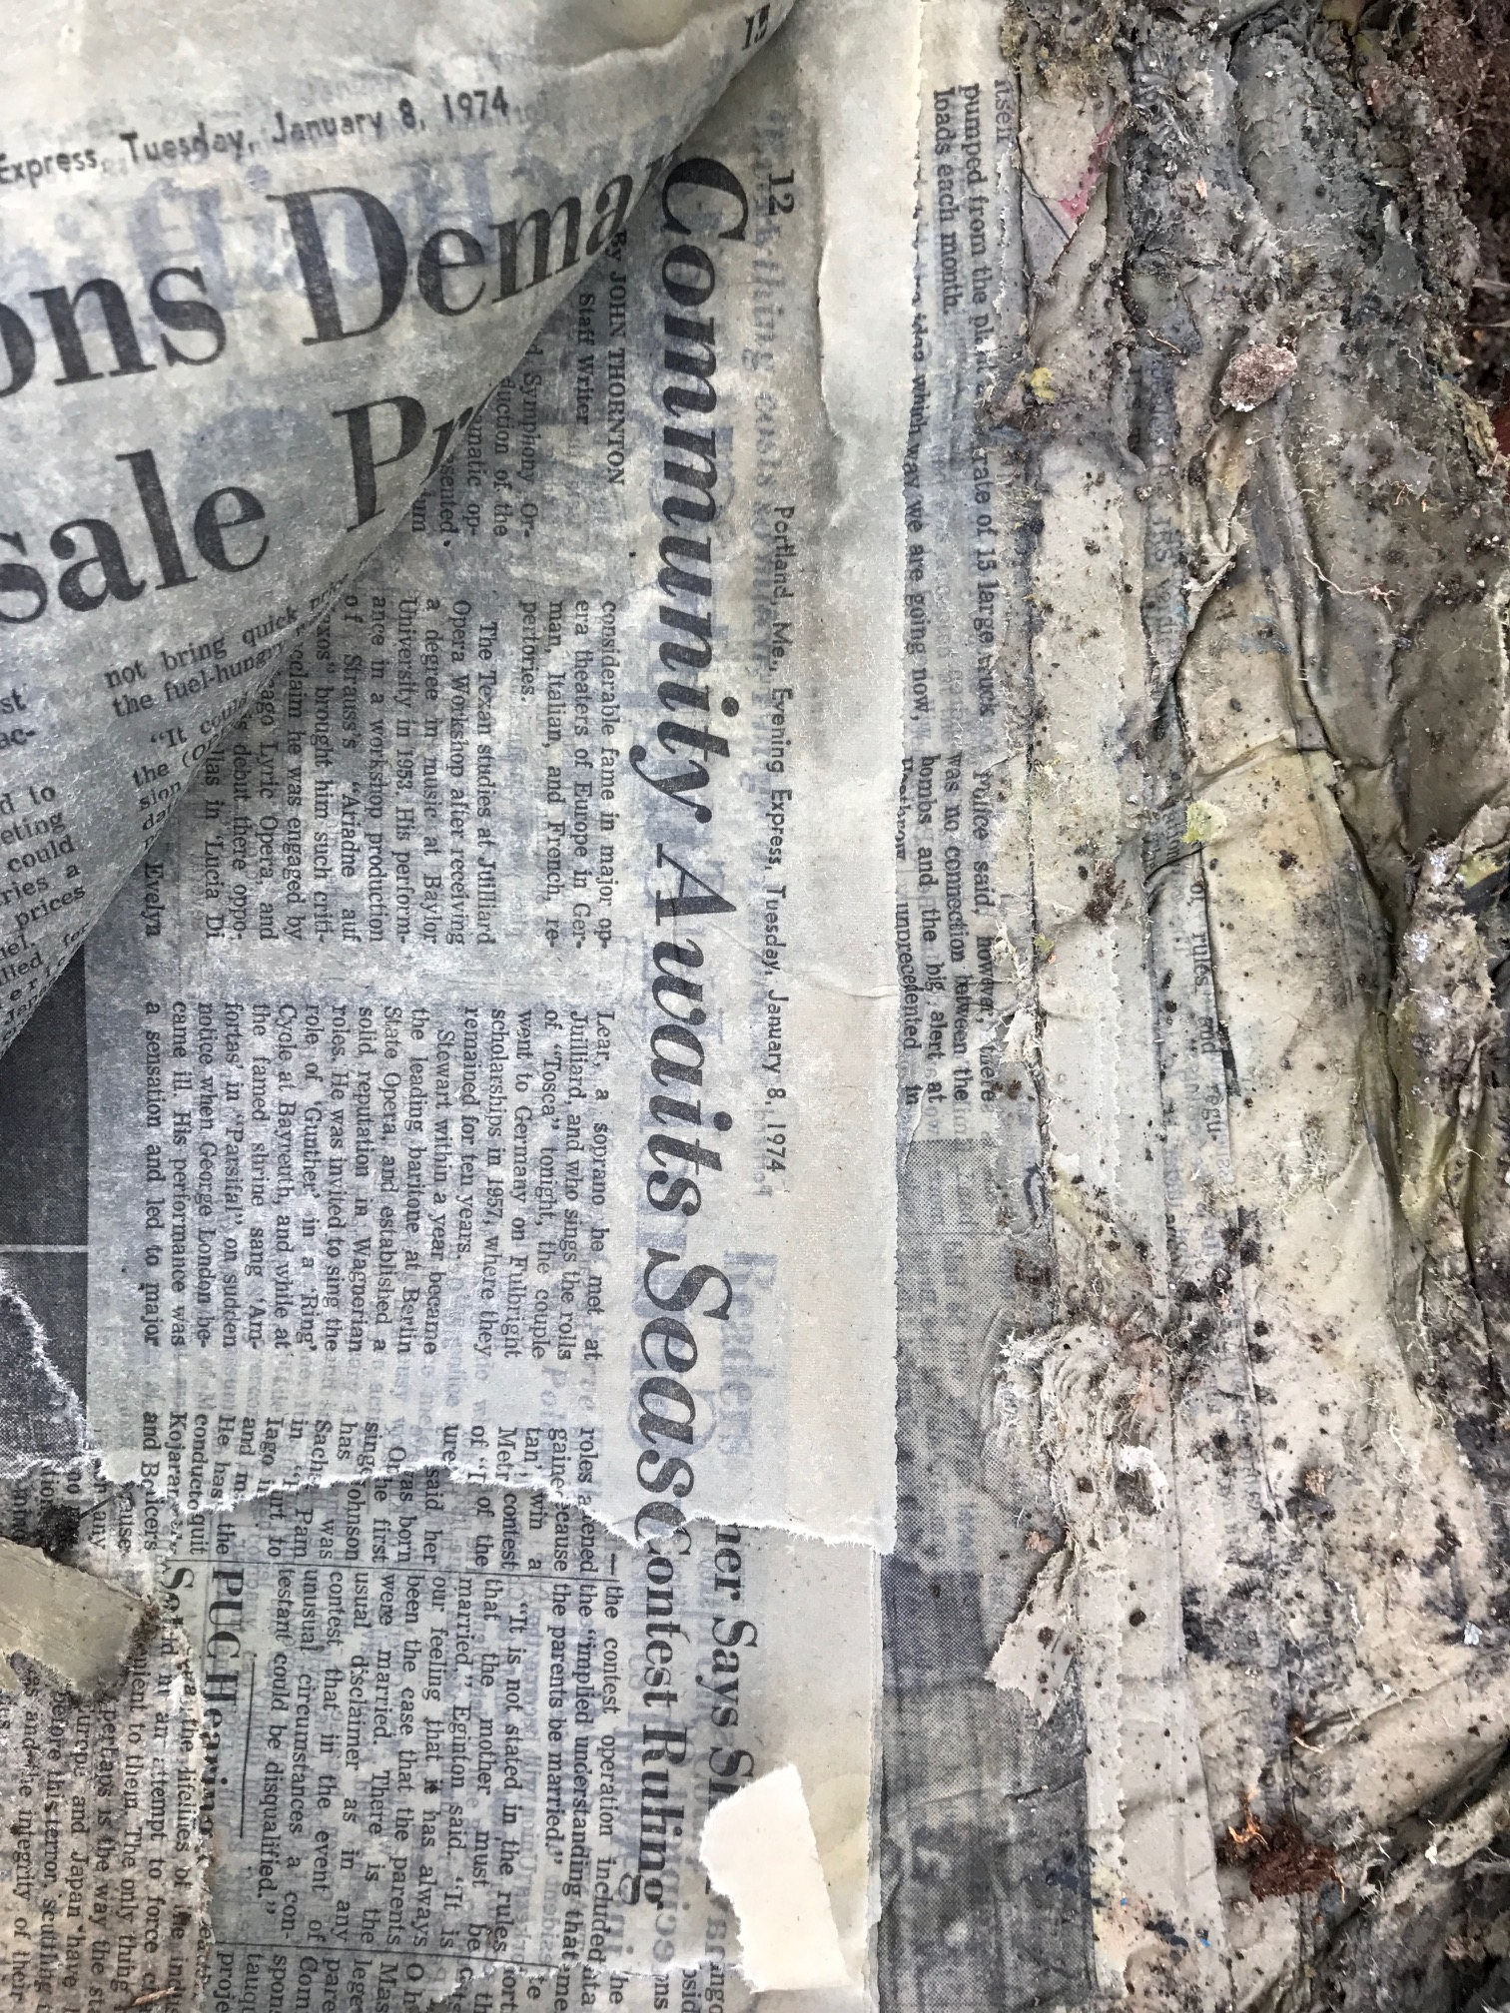
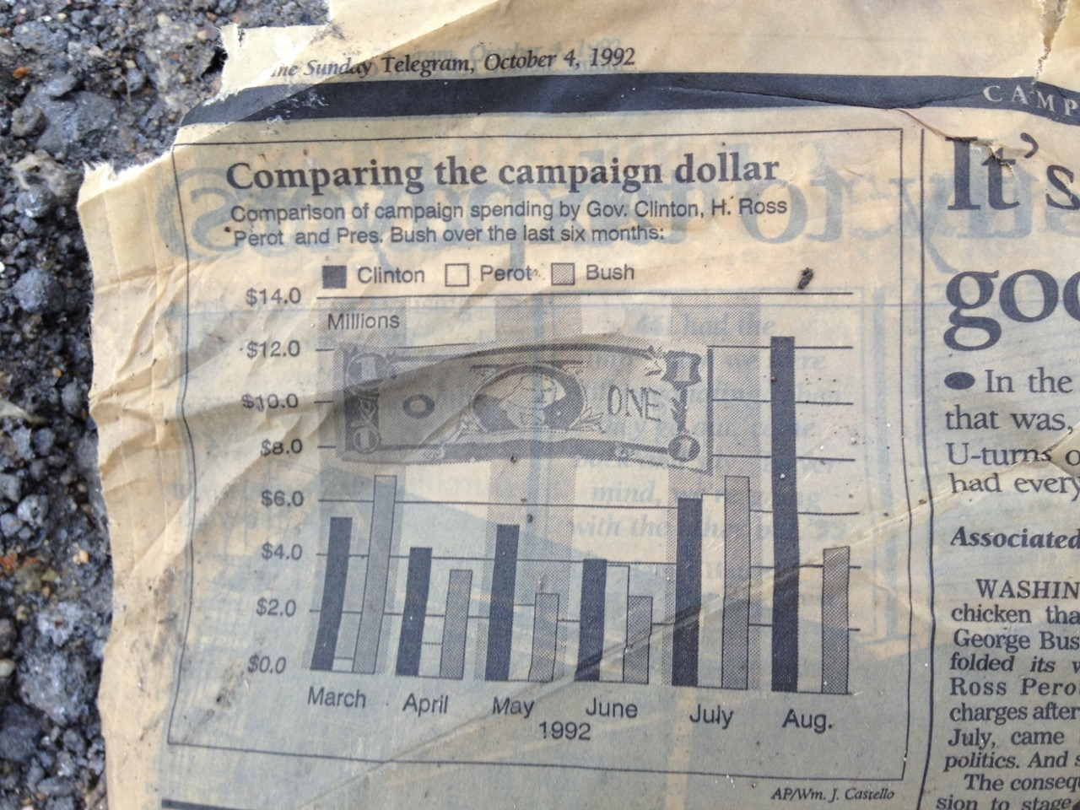
Landfilled Newspapers from long ago…
1974
1992

Slide 4
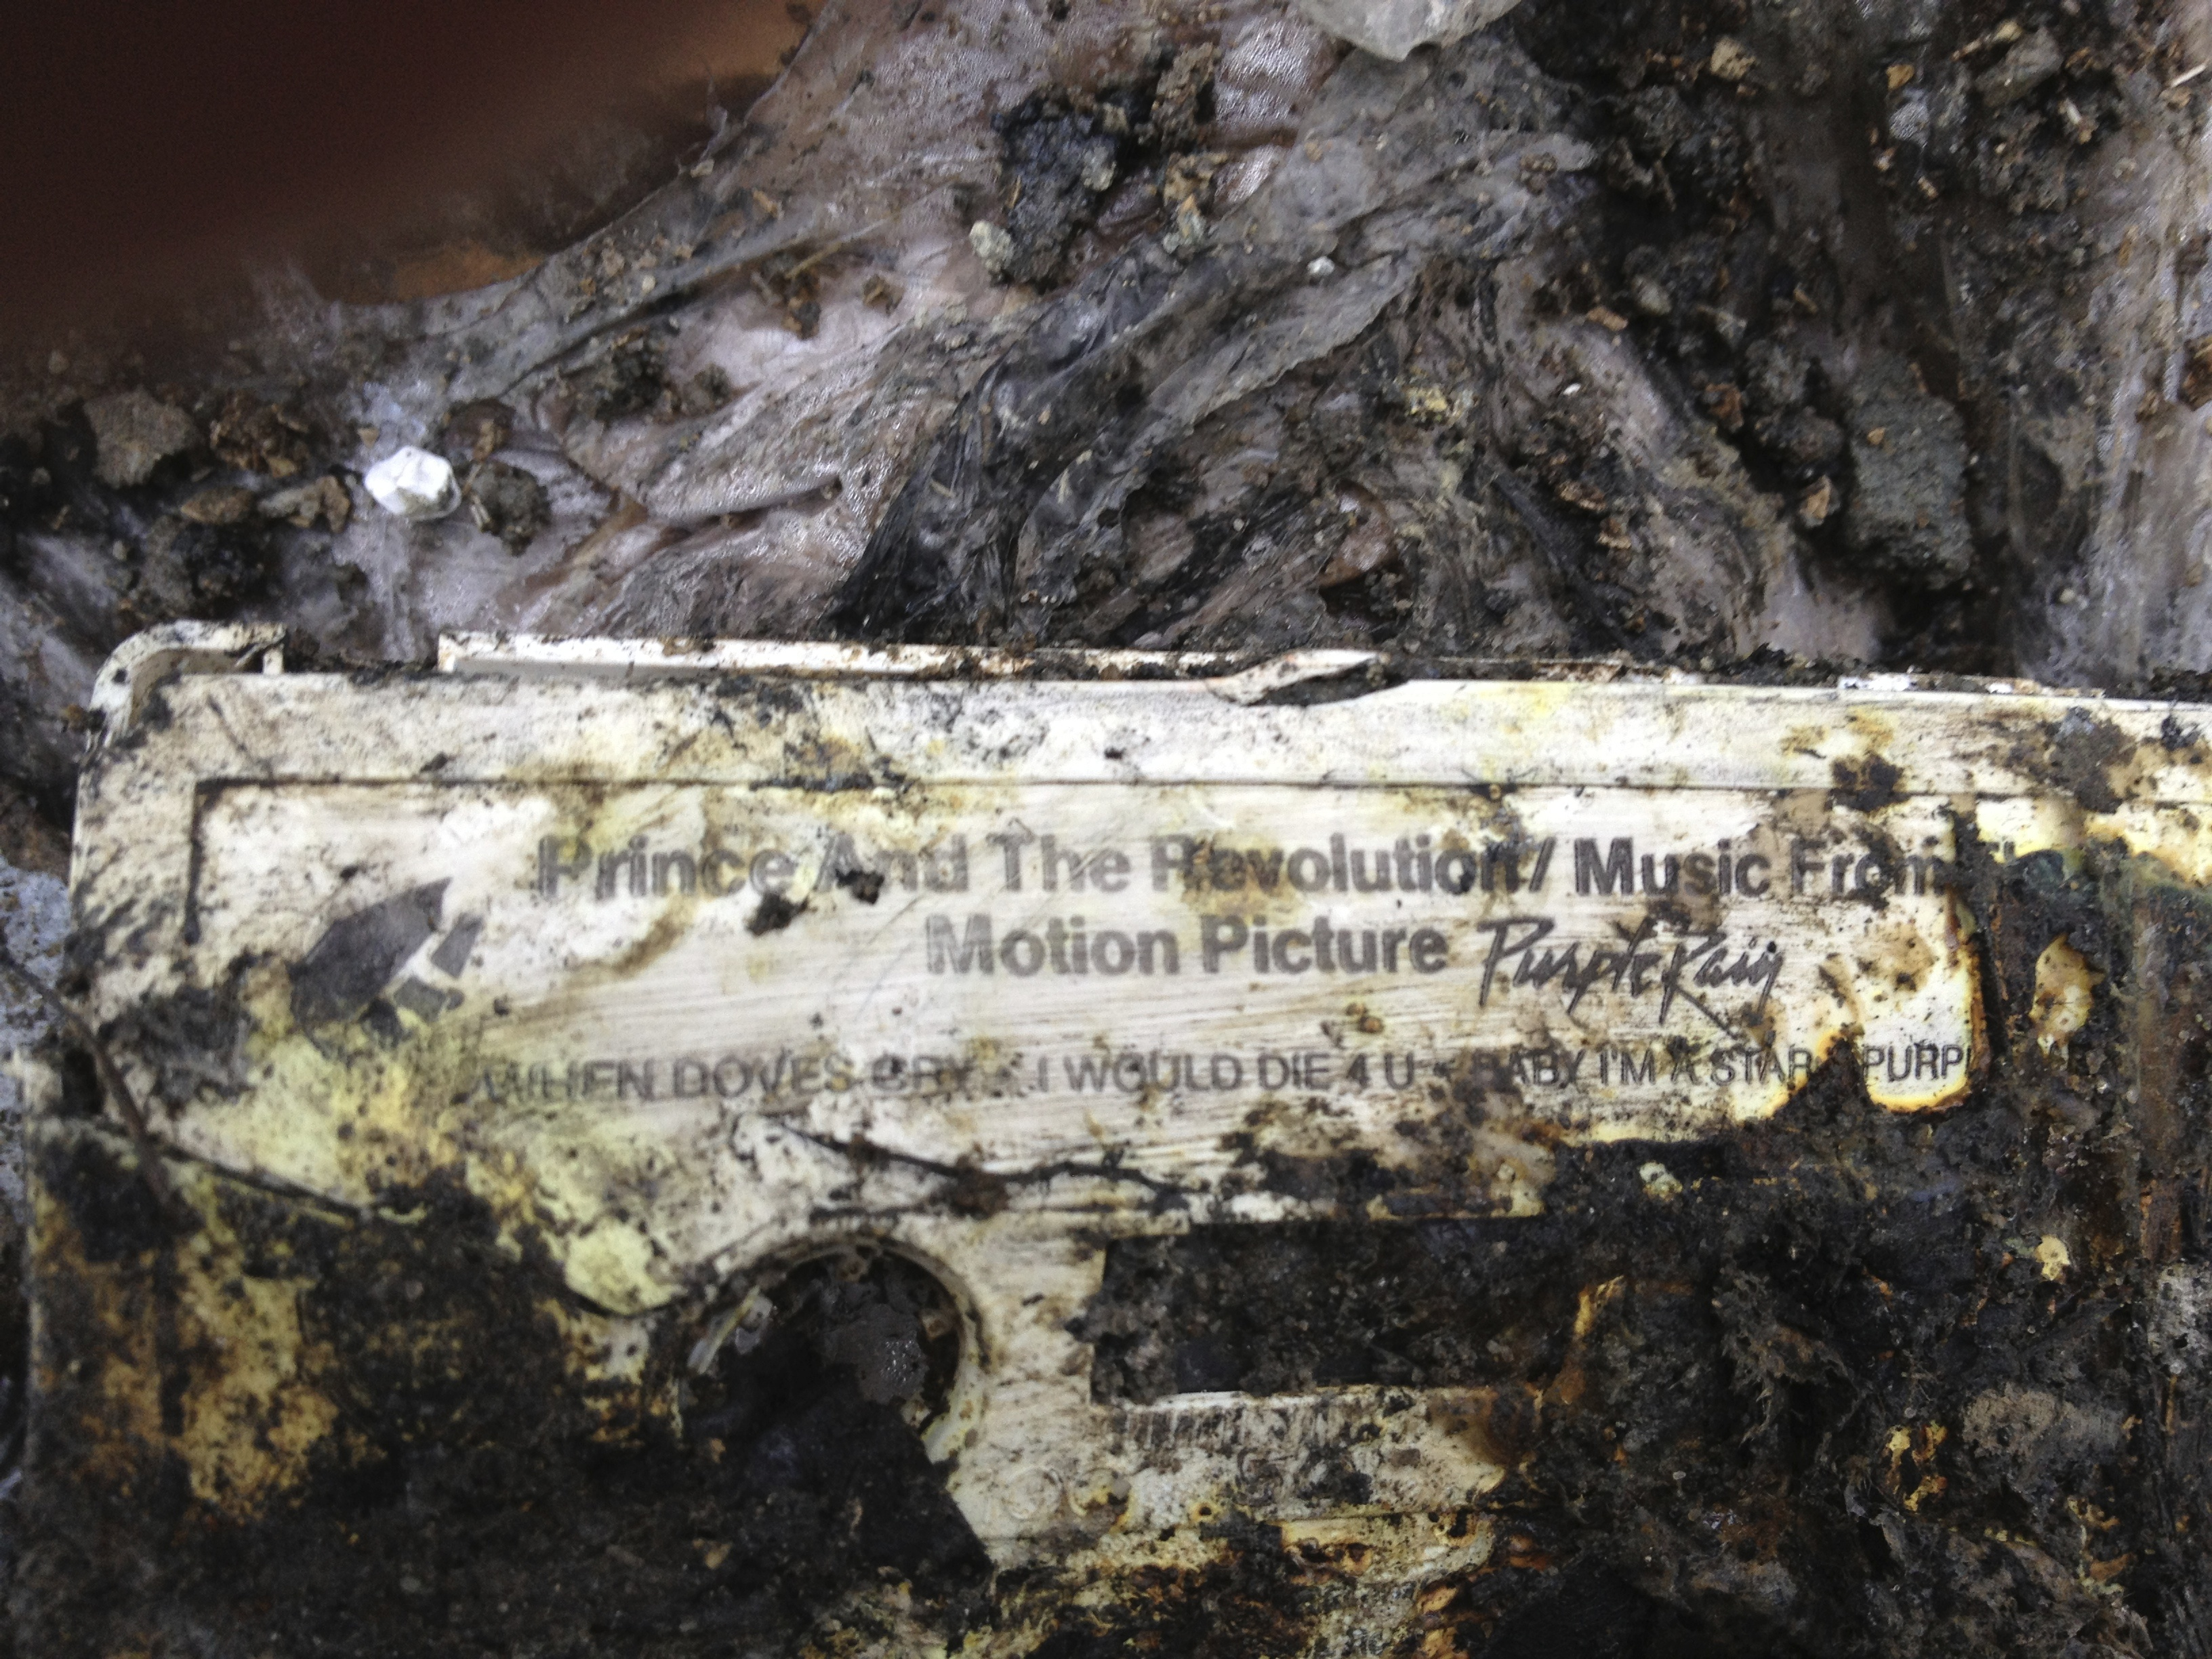

Slide 5
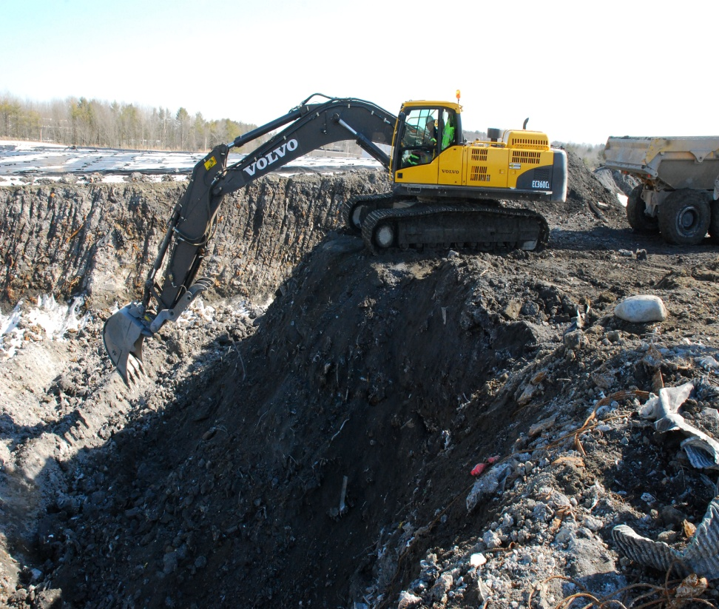
Mining the Landfill

Slide 7
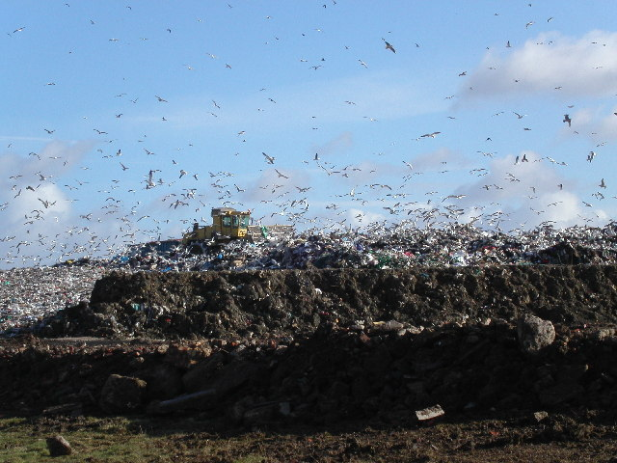
Landfill Storage is Forever

Slide 8
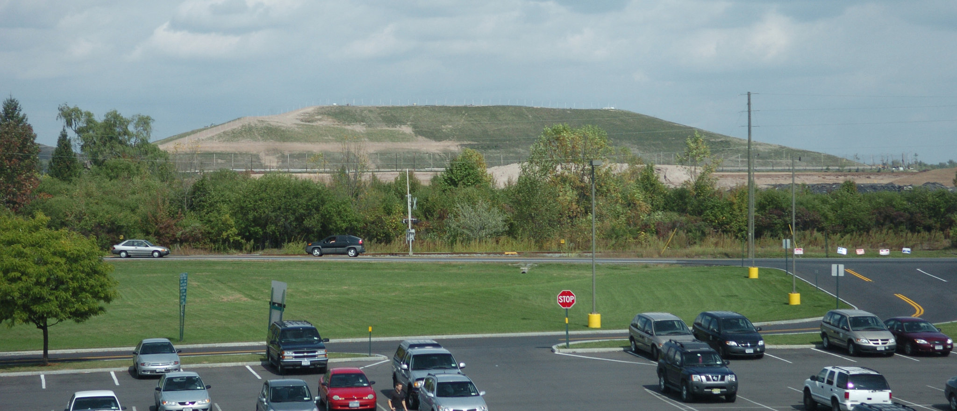
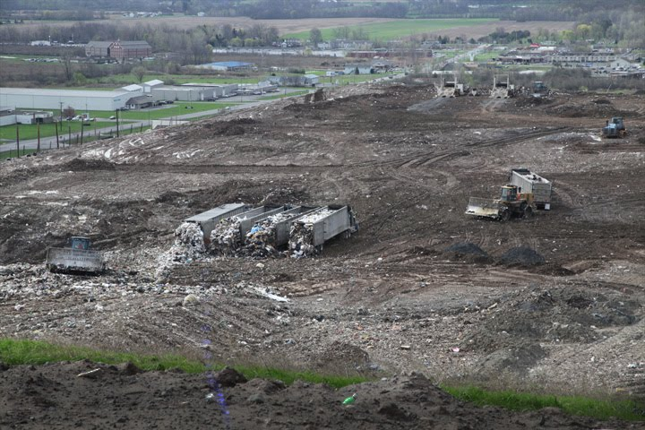
Landfill Storage - GROWING

Slide 9
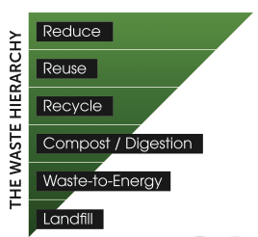
ecomaine
Our Mission
ecomaine provides comprehensive long-term solid waste solutions
in a safe, environmentally responsible, economically sound manner, and is a leader in raising public awareness of sustainable waste management strategies.
Notes:
Why Food waste recovery?
It’s consistent with the waste hierarchy.
Push our recycling rates in Maine from 35% to 50%, reaching the State’s recycling goal!
Reduce greenhouse gas emissions from landfills.
Generate electricity through a renewable resource more efficiently.
Provide alternatives to chemical fertilizers to build soil fertility.
Ruffles Potato Chips in the landfill!

Slide 10
The ecomaine Facilities & Programs
Facilities:
Single-Sort Recycling
Food Waste Recovery
3. Waste-To-Energy
4. Ashfill – Landfill
Outreach Programs:
Tours and Open House
School Presentations
School Recycling Grants
Eco-Excellence Awards
Fairs, Festivals, and Events
TV, Radio, and Print
Social Media

Slide 11
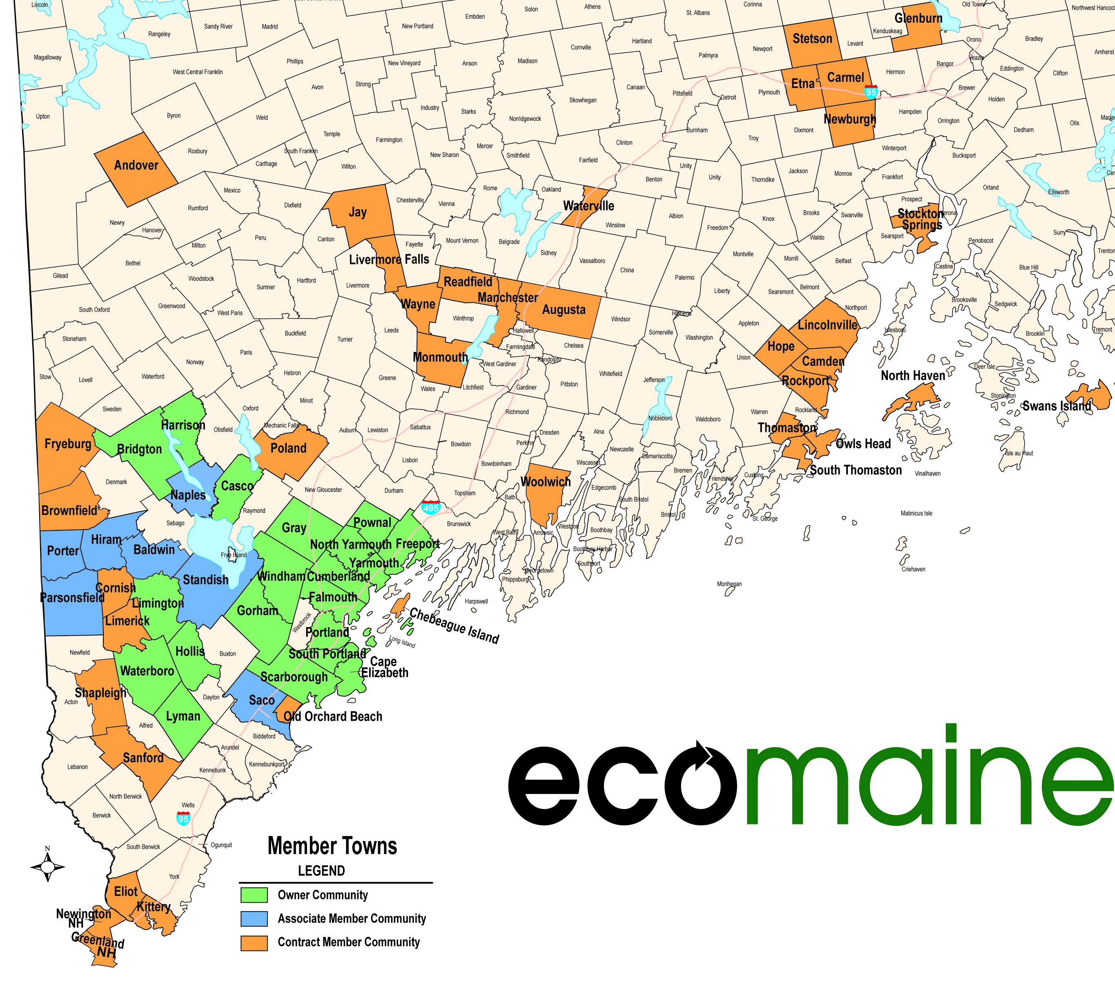
ecomaine member Communities
Notes:
65 communities working together on diverting waste from landfills.

Slide 12
Markets Crash for Recyclables

Slide 13
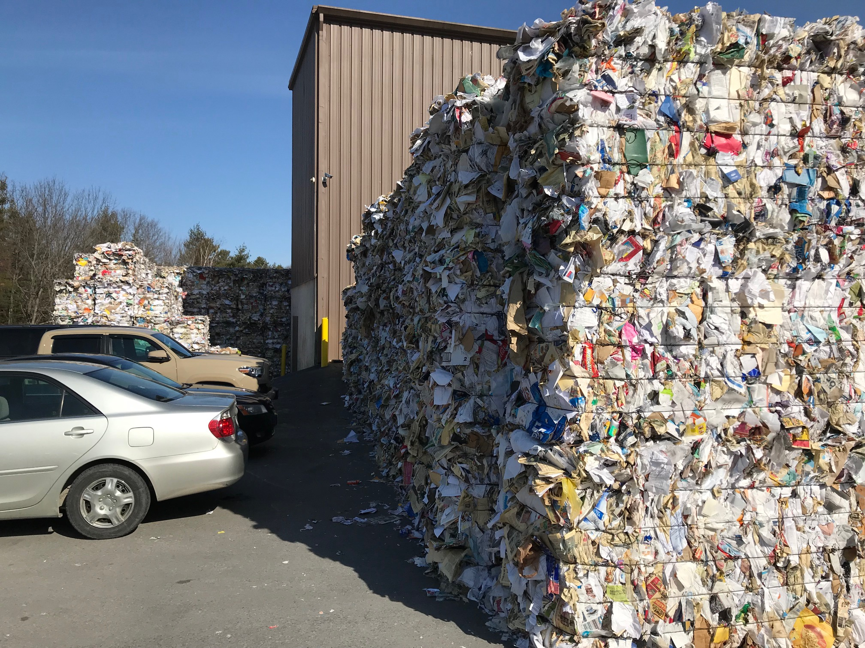
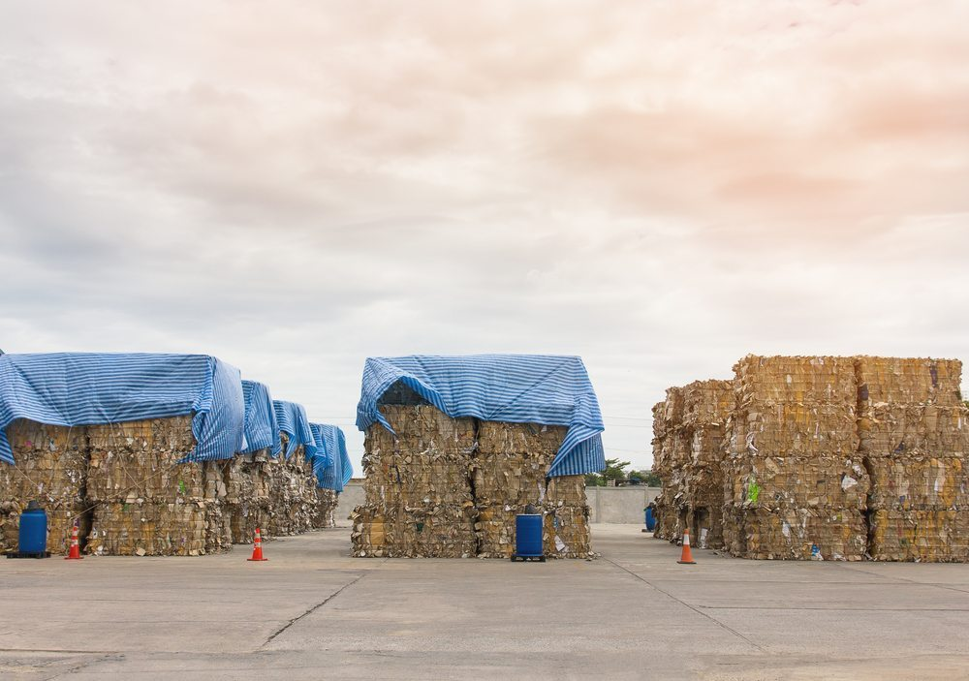
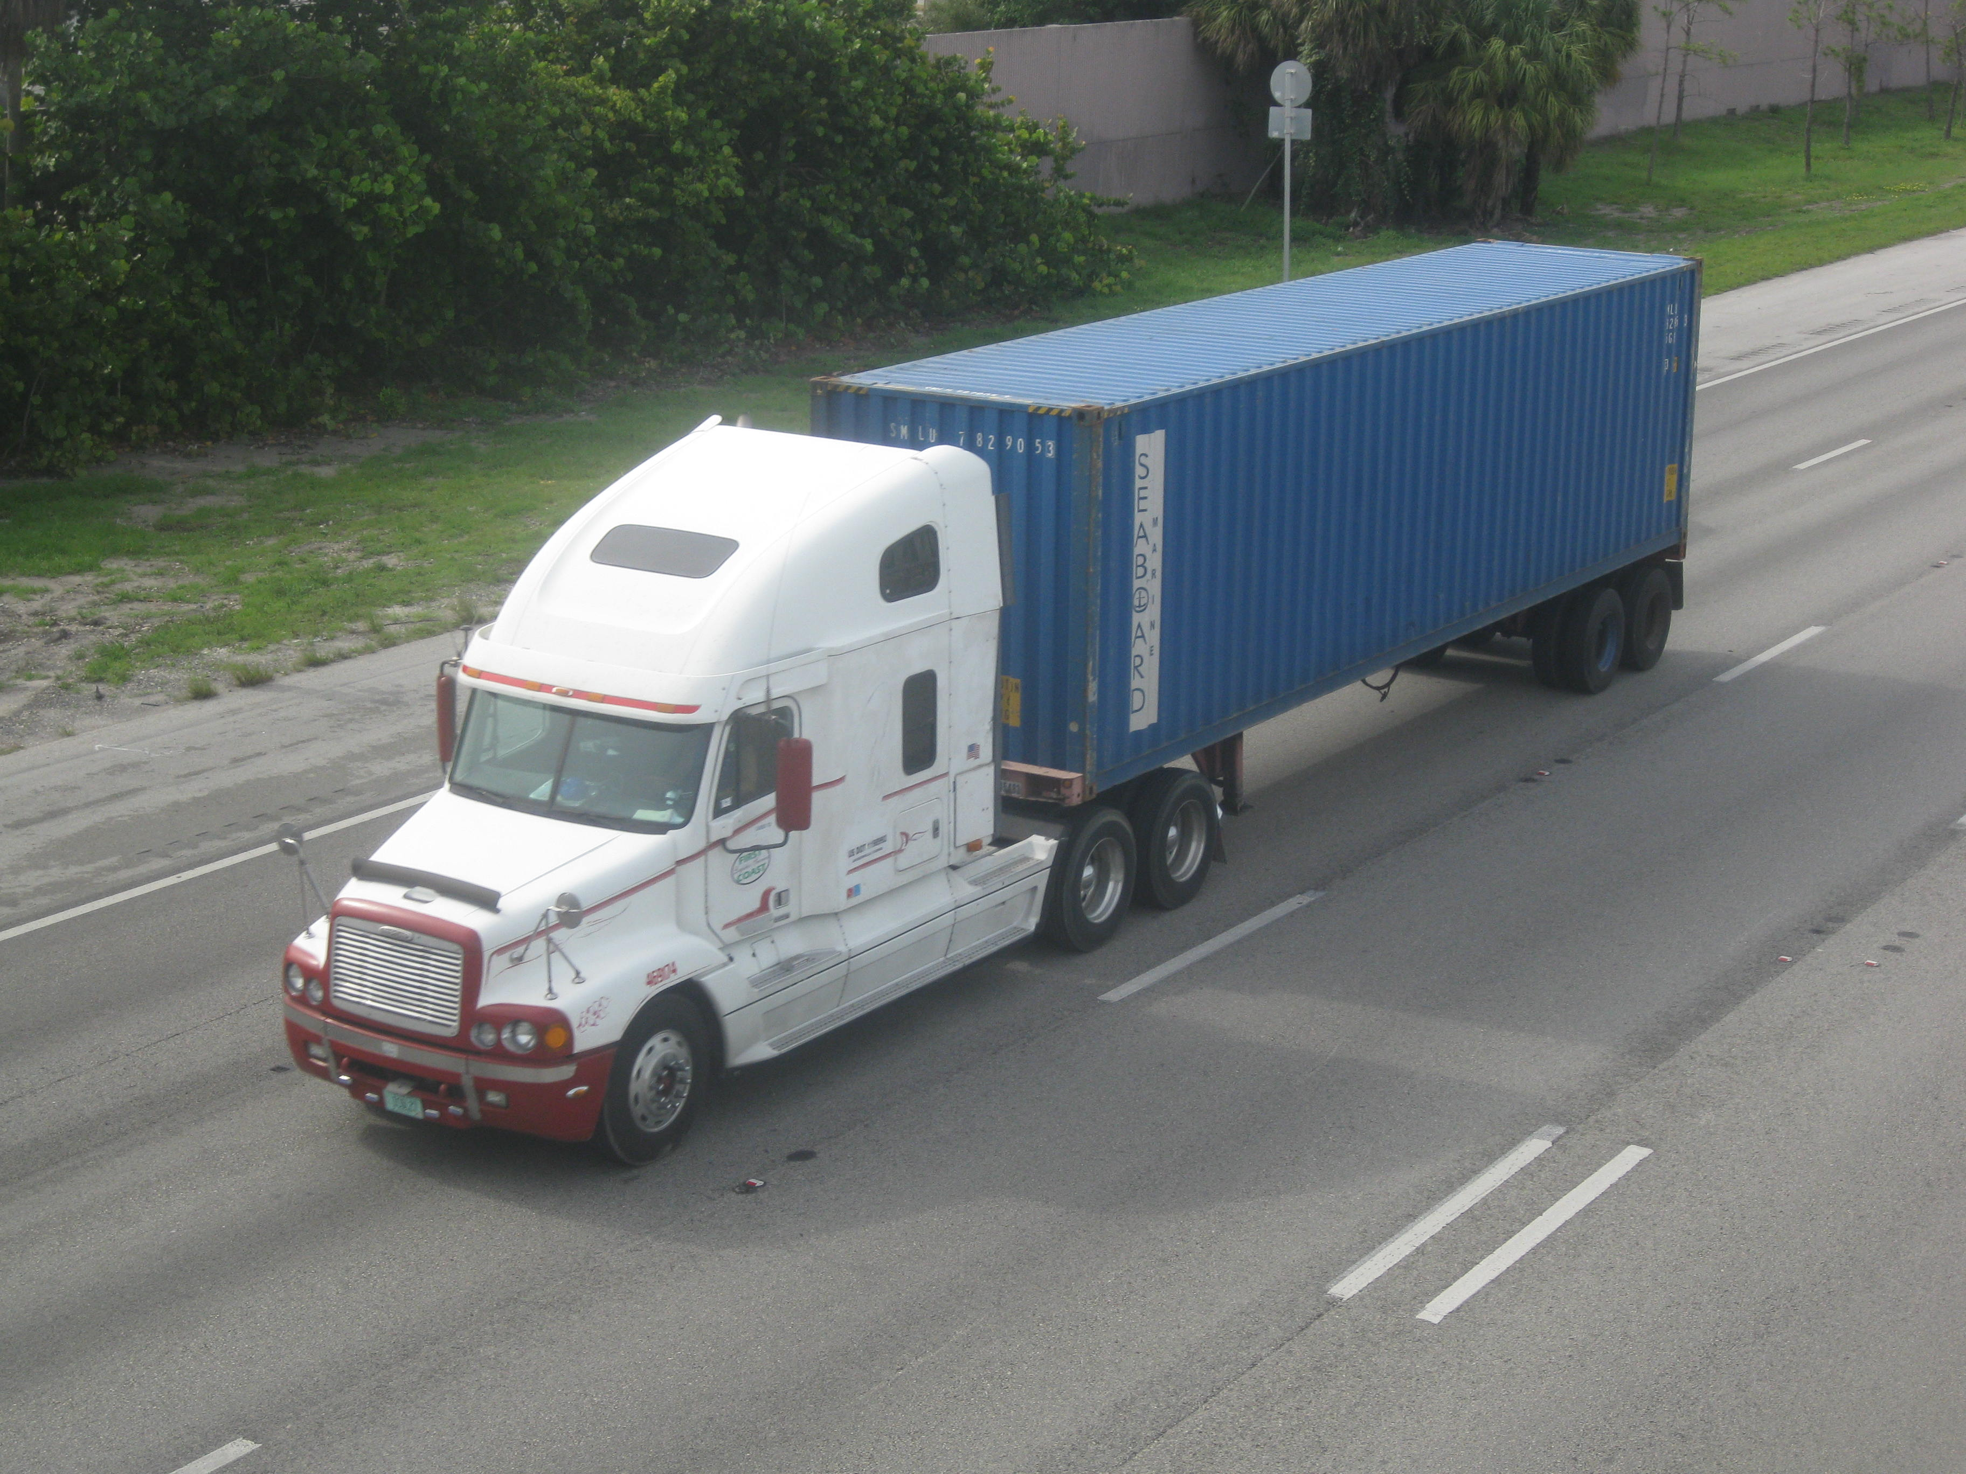
Waiting for Orders, Trucks, and Containers to Show Up

Slide 14
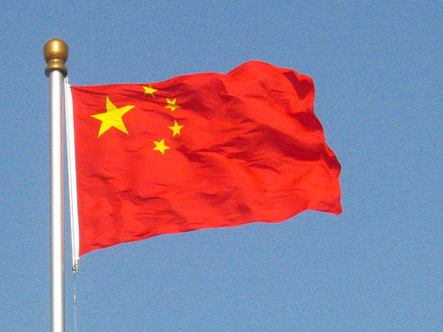
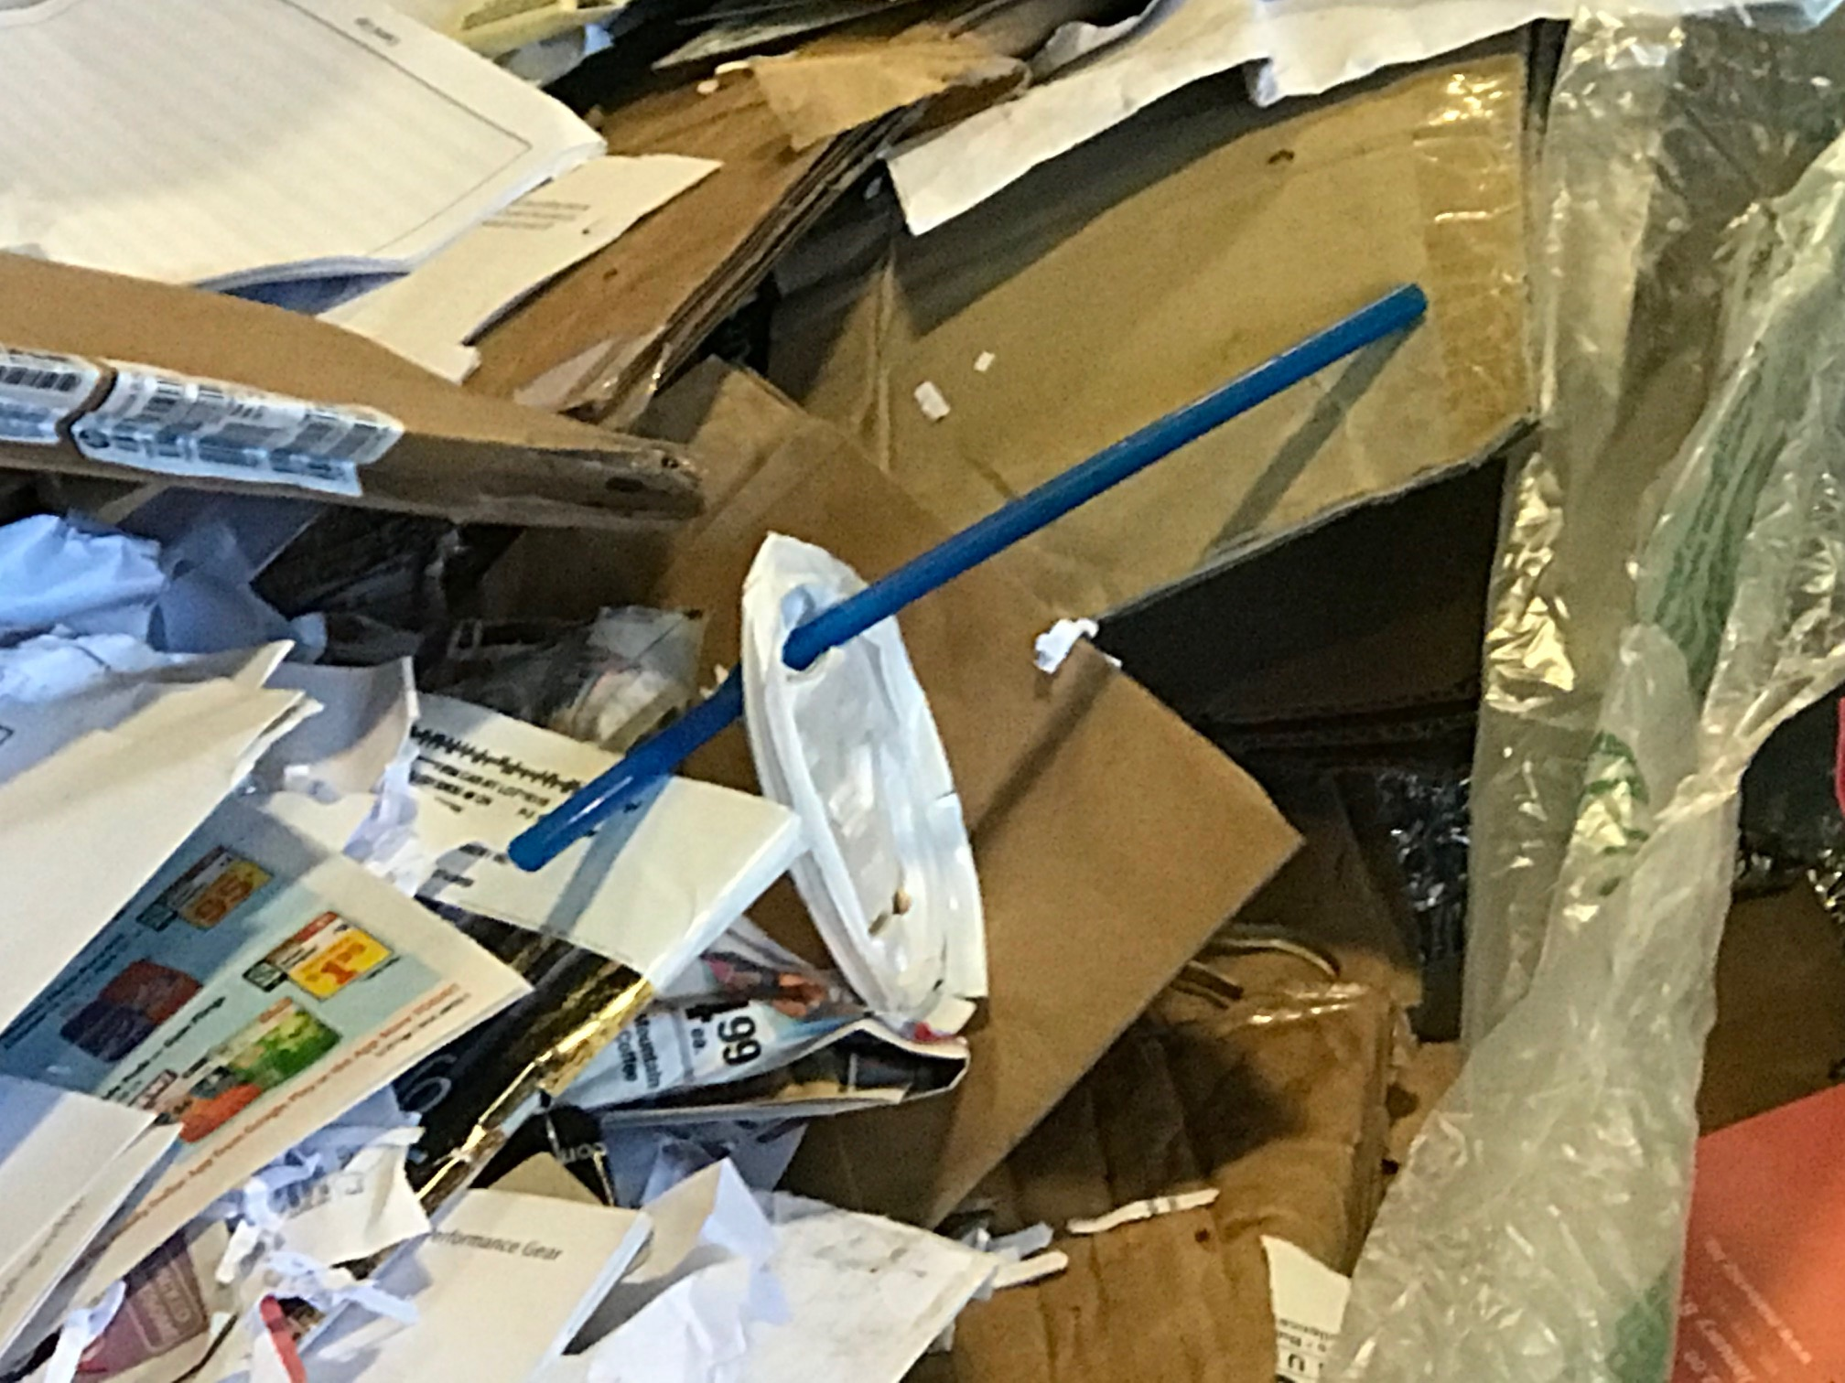
Why?
Supply & Demand: China’s ban on imports has left the market out of balance
Newspapers: They’ve disappeared leaving behind a much different grade of paper
Contamination: (trash mixed in recyclables) = No Tolerance

Slide 15
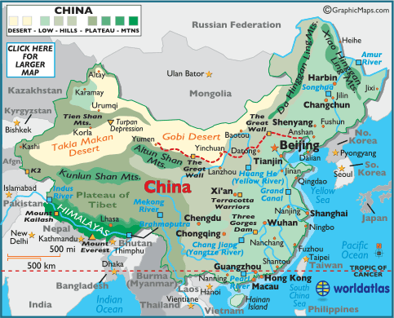
The Transition from Maine Markets to China

Slide 16
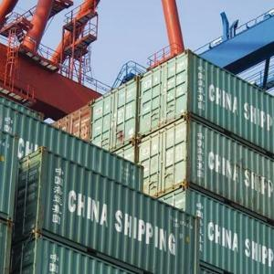
National Sword – Ban on Scrap Imports
“It may (the ban) result in chaos in society … some voices that have been critical of the Chinese policies are downplaying their own culpability or responsibility to adjust accordingly.”
Li Ganjie
China’s Minister of Environmental Protection
March 17, 2018
Photo credit: DC Environmental
Notes:
We began feeling the effects of this in September 2017, when China stopped accepting imports of paper.

Slide 17
China’s clamp down began over 10 years ago
2006 – 2011: Chinese import regulations were passed 2006-2011.
2011: Article 12 stated “In the process of importing solid waste, measures shall be taken to prevent it (imports) from spreading seepage and leakage or other measures to prevent pollution of the environment”.
2013: “OPERATION GREEN FENCE” - Formally Implemented in February of 2013 to enforce regs enacted in 2011 (Article 12). The Green Fence was an aggressive inspection effort aimed at reducing the amount of contaminated recyclables. Obviously economics played a significant role as well.
2013: 22,000 containers were rejected the first year of Operation Green Fence.
2015: Customs Crackdown aimed at identifying imported loads containing solid waste.
2017: National Sword
Paper Glut

Slide 18
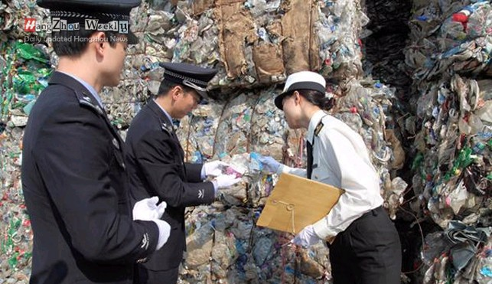
China’s Import Bans
Waste & Recycling Import Bans
Stringent Restrictions – 0.5% Contamination
Tougher Enforcement and rejections
Customs Crackdown - Inspections
Notes:
The Green Fence came about when China launches intensive inspections (and many rejections) of nearly every incoming container to enforce import regulations passed in 2006 and 2010. It was officially slated to end in November 2013 but could restart anytime.
Then in November 2015, another two-month crackdown ensued, this time inspecting the processors and agreed-upon handling requirements instead of the loads on the dock. This resulted in a new set of loading and communication standards that required the addition of a supervisor recycling staff role here at ecomaine, given paper is 60% of the material we process through our facility every day.

Slide 20
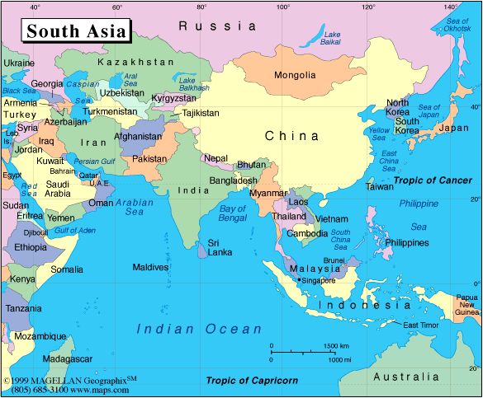
US Exports of Recovered Paper
Country | 2016 | 2017 | % Change
China | 13,210,375 | 10,887,269 | -18%
India | 1,561,837 | 1,930,720 | +24%
Vietnam | 120,673 | 397,162 | +229%
Canada | 674,788 | 743,210 | +9%
Indonesia | 381,358 | 440,585 | +16%
Waste Dive, 2/16/18, C. Boteler

Slide 21
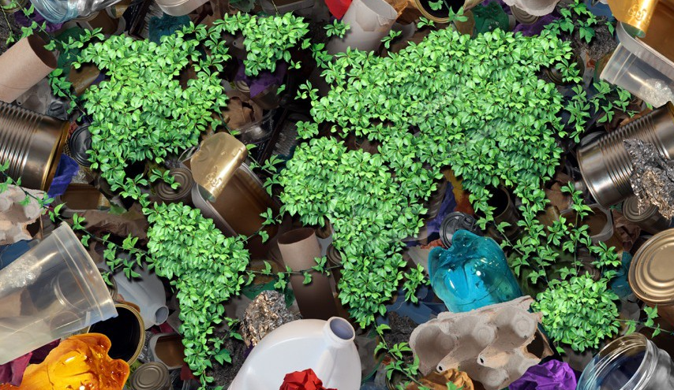
Finding new recycling markets
India
Indonesia
Vietnam
Korea
Cananda & US
Photo credit: WasteExperts.com

Slide 22
Recycled Plastic Exports to China

Slide 23
2017 EU Paper Exports to China

Slide 24
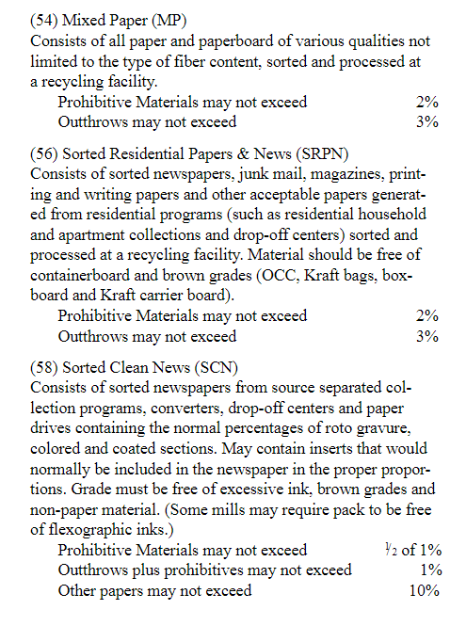
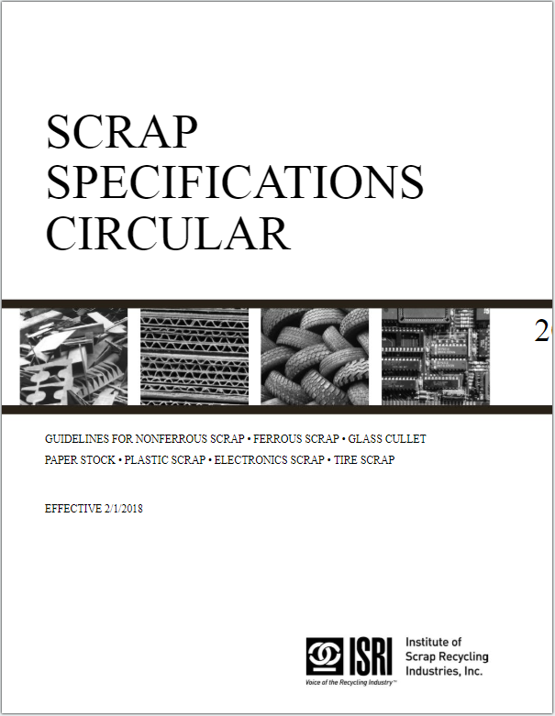
Paper Grades

Slide 25
ISRI specifications vs China
Material | ISRI Prohibitives and Outthrows | China
Sorted Residential Papers (56) | 2% Prohibitives & 3% Outthrows | 0.5%
Mixed Paper (54) | 2% Prohibities & 3% Outthrows | 0.5%
Prohibitives = Unusable
Outthrows = Unsuitable

Slide 26
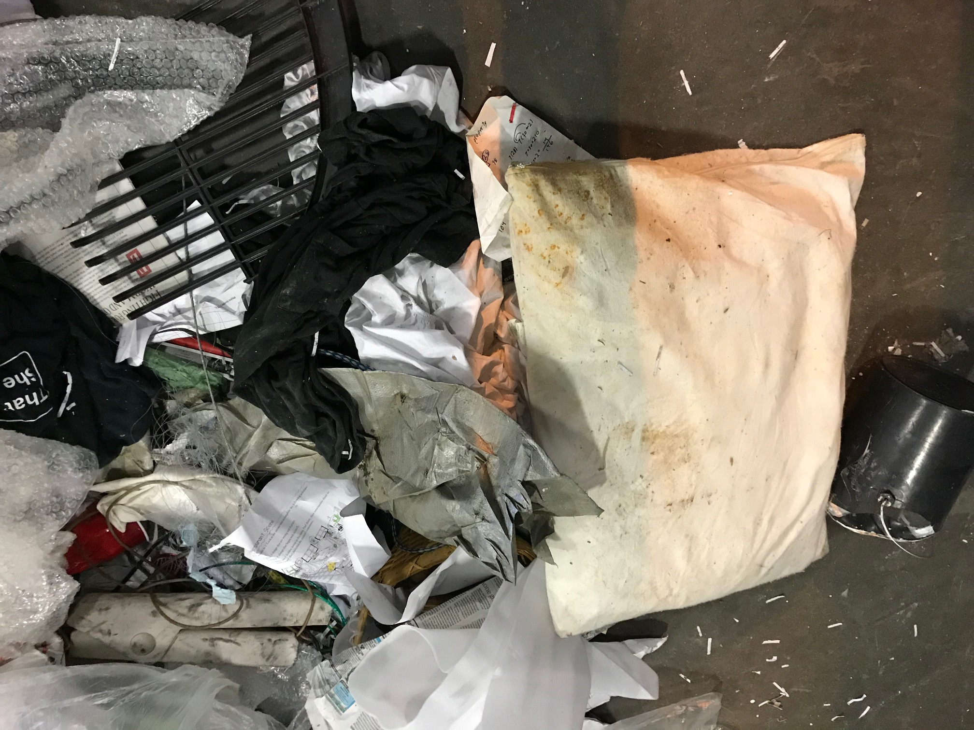
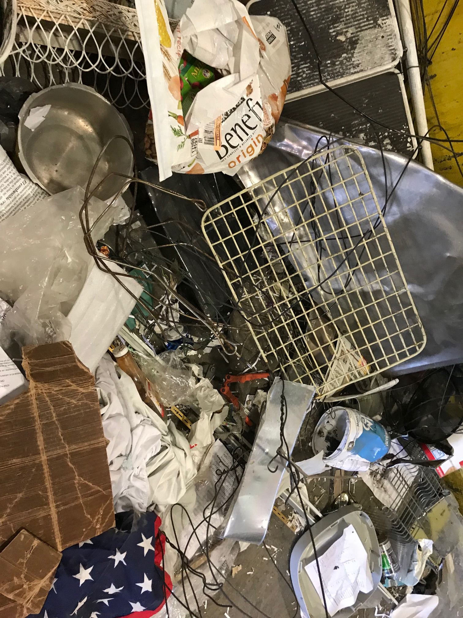
Contamination

Slide 27
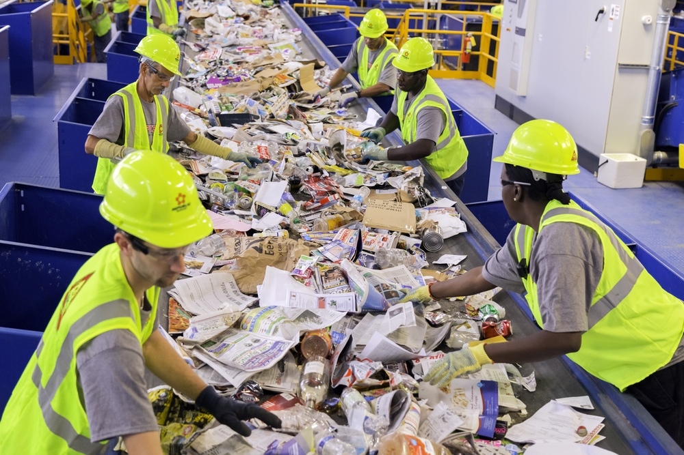
Sorting Facilities – Cost to Remove Contaminants
Facility Design Expectations
Labor Shortage
Cost of Labor
Pressure to keep up
Markets Dictate Quality

Slide 28
We All Play a Role in this Challenge
Reducing Contamination at the Source & Public Education
Recycling Facility – Removing Contaminants
Technology Improvements
Newspapers Will Continue to Disappear
Have We Reached PEAK Cardboard?
How will packaging continue to change?
Waste Hierarchy Alternatives
Leadership - Champions

Slide 29
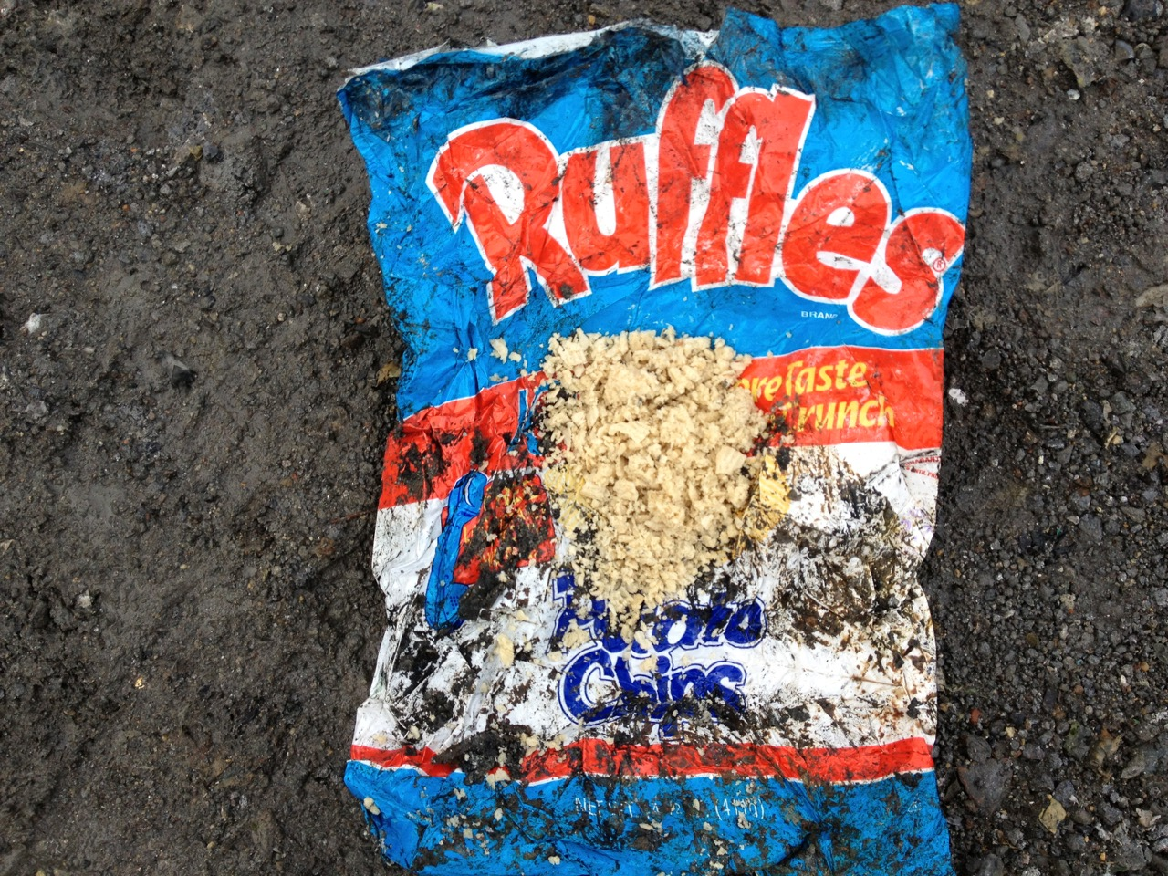
Thank You! Questions?

